Slide 1
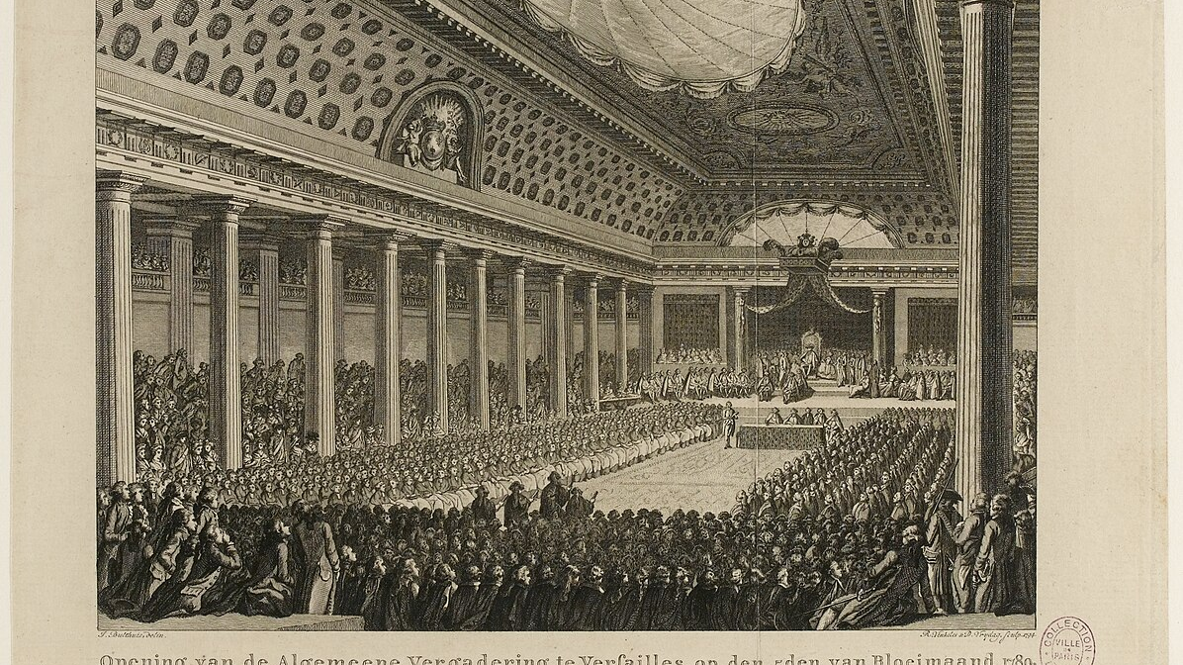


The Logic of Political Parties
Guest Lecture #4 (Mr. Wetsel)

Slide 2

Agenda
1
2
3
Knowledge
Check
Underlying Mechanisms
Going Forward

Slide 3
Part I. Knowledge Check

Slide 4
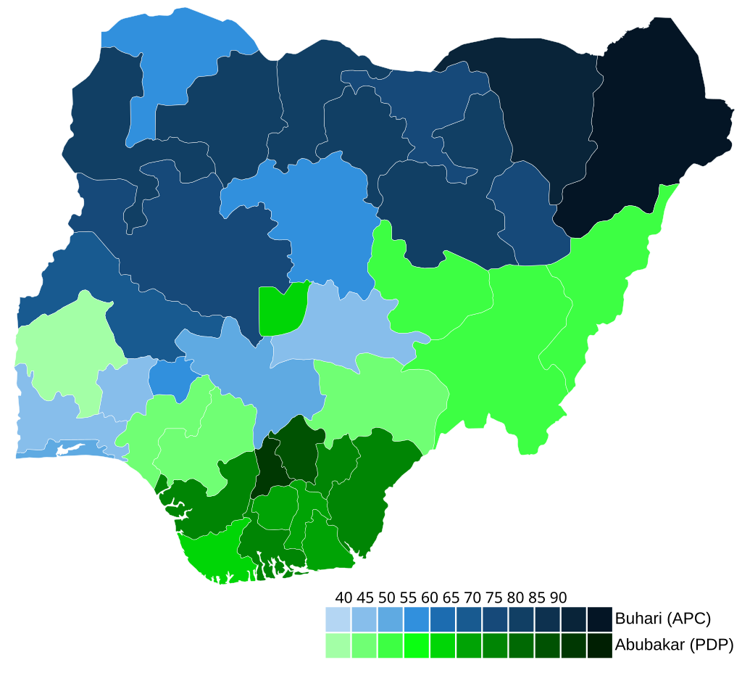


What is a political party and Why do democracies have them?

Slide 5
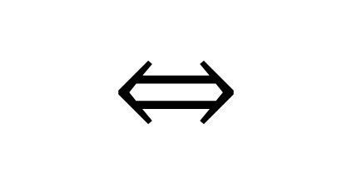
A dual, complementary basis…
$$⇔$$
Ontology
Teleology

Slide 6
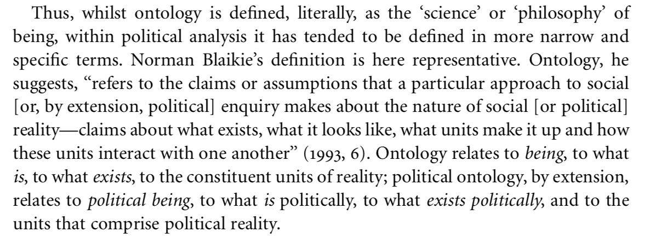
A dual, complementary basis…
Ontology

Slide 7
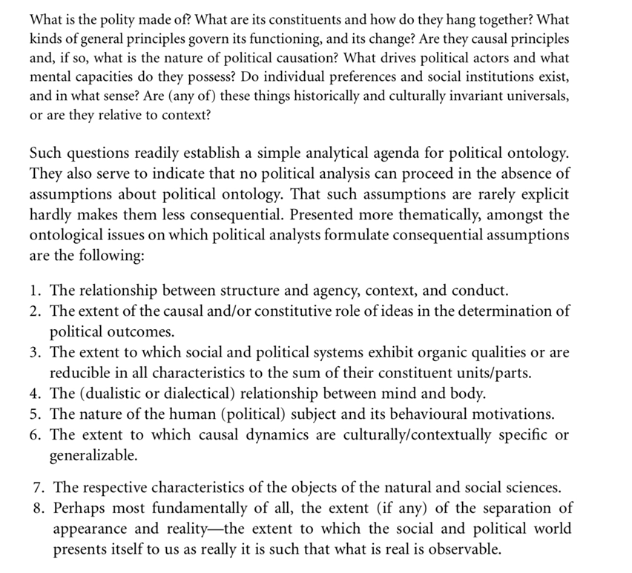
A dual, complementary basis…
Ontology

Slide 8
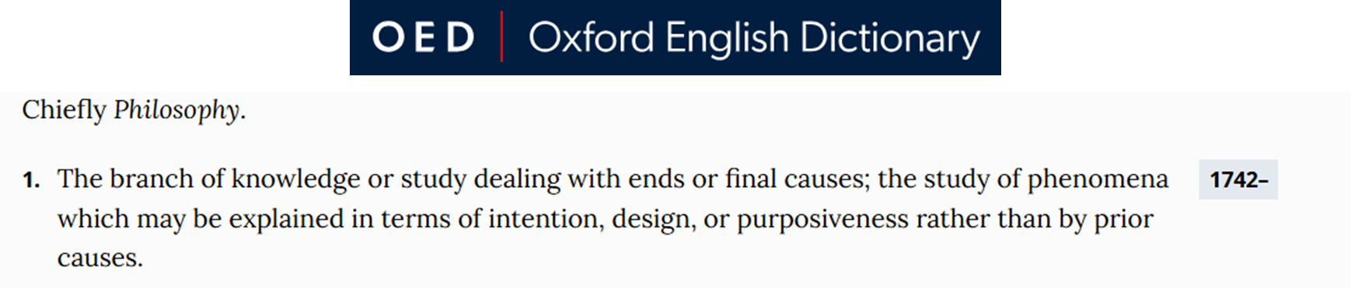
A dual, complementary basis…
Teleology

Slide 9
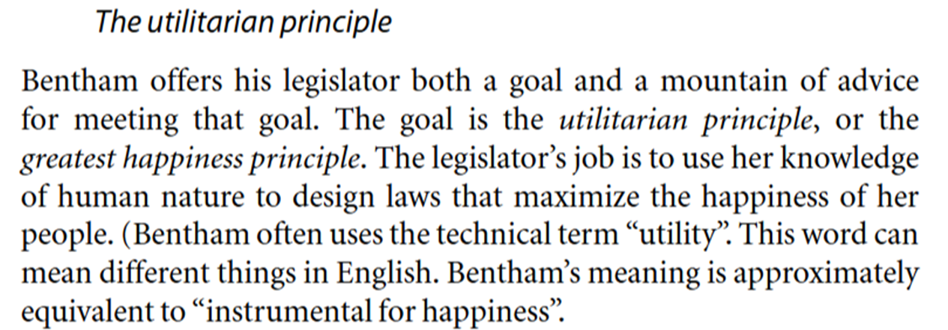
A dual, complementary basis…
Teleology

Slide 10
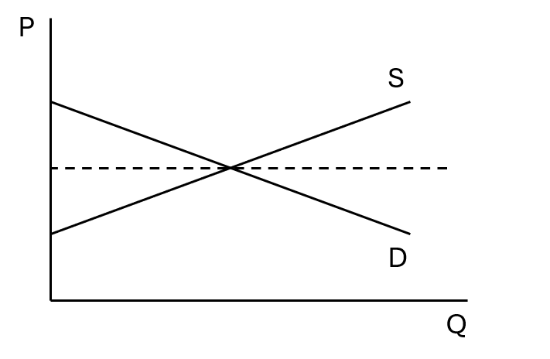
A dual, complementary basis…
Supply & Demand

Slide 11
Part I. Knowledge Check (RECAP)

Slide 12
Part II. Underlying Mechanisms

Slide 13
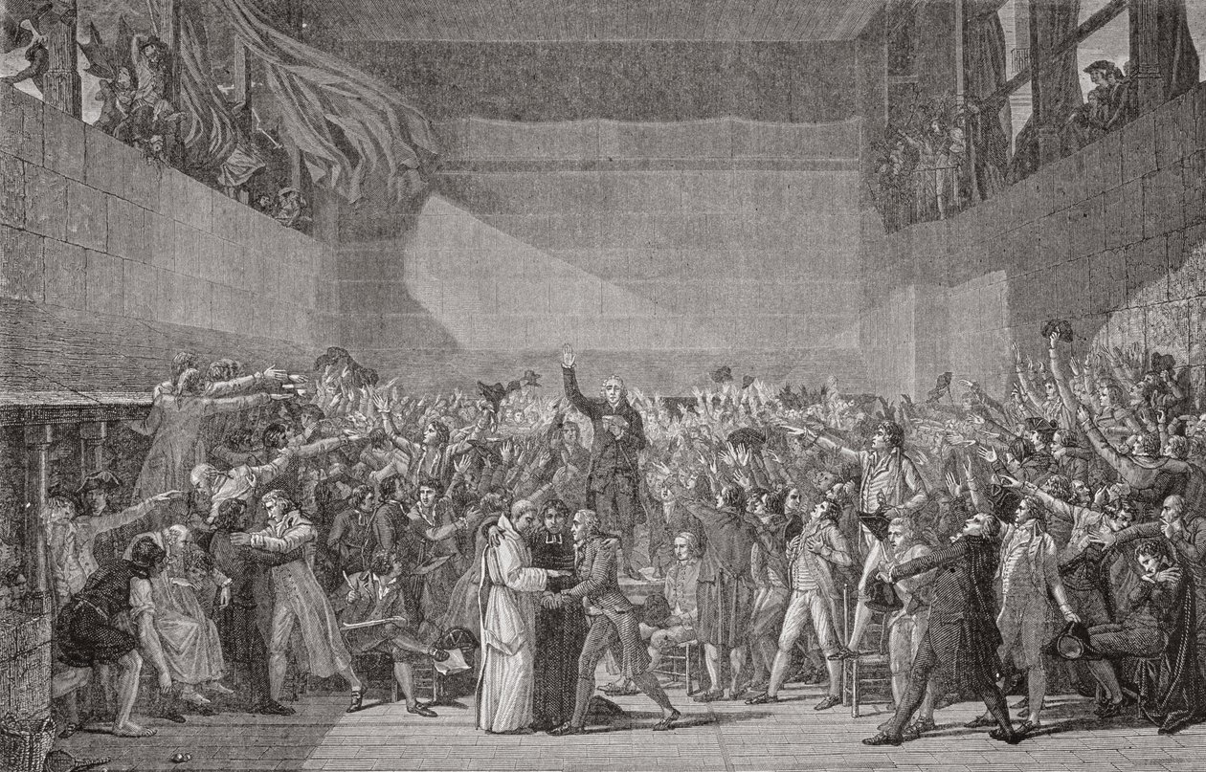
Preference Aggregation: A Collective Action Problem

Slide 14
Preference Aggregation: A Collective Action Problem
Public Goods Theory
RCT Assumptions
Non-Excludable & Non-Rivalrous
Free Rider Problem
+/- Externalities
Rational Ignorance
Opportunity Cost of Information
Probability of Being the ‘Decisive Vote’
Asymmetric Information
Credible Signaling
Stated vs. Revealed Preferences
Recency Bias

Slide 15
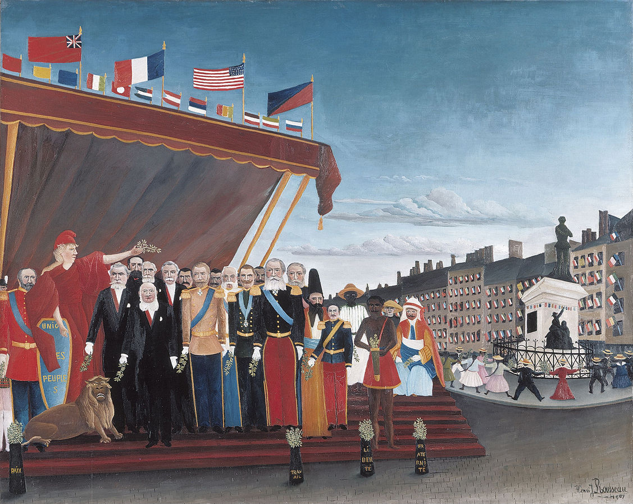
Delegating Authority: A Principal Agent Problem

Slide 16
Delegating Authority: A Principal Agent Problem
Moral Hazard
Adverse Selection
Credible Enforcement of the ‘Political Contract’
Delegates vs. Trustees
Multiple Principals
CBDC
Shirking and Reneging

Slide 17
Part II. Underlying Mechanisms (RECAP)

Slide 18
Part III. Going Forward

Slide 19
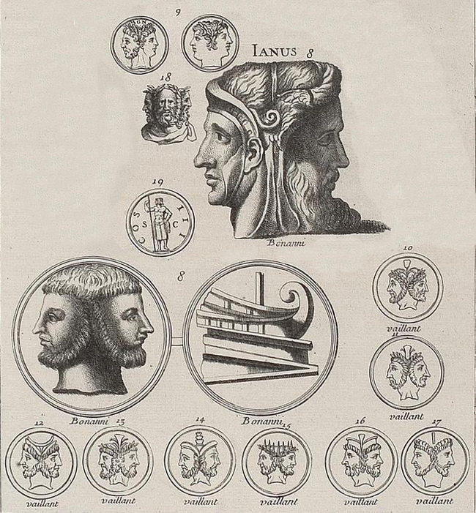
The Duality Principle of Representative Government
coincidentia oppositorum

Slide 20
The Duality Principle of Representative Government
De Jure / De Facto
Centripetal /Centrifugal
coincidentia oppositorum

Slide 21
Part III. Going Forward (RECAP)

Slide 22
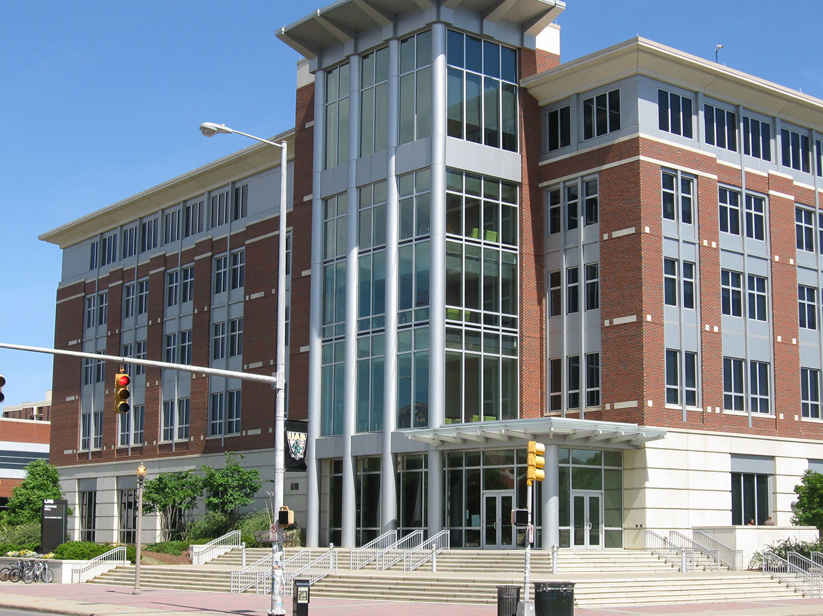

Thank You!

